Slide 1
5.2
Concurrency Control

Slide 2
Purpose of Concurrency Control
To ensure that the Isolation Property is maintained while allowing transactions to execute concurrently (outcome of concurrent transactions should appear as though they were executed in isolation).
To preserve database consistency by ensuring that the schedules of executing transactions are serializable.
To resolve read-write and write-write conflicts among transactions.

Slide 3
Concurrency Control Protocols (CCPs)
A CCP is a set of rules enforced by the DBMS to ensure serializable schedules
Also known as CCMs (Concurrency Control Methods)
Main protocol known as 2PL (2-phase locking), which is based on locking the data items

Slide 4
2PL Concurrency Control Protocol
Based on each transaction securing a lock on a data item before using it:
Locking enforces mutual exclusion when accessing a data item – simplest kind of lock is a binary lock, which secures permission to Read or Write a data item for a transaction.
Example: If T1 requests Lock(X) operation, the system grants the lock unless item X is already locked by another transaction. If request is granted, data item X is locked on behalf of the requesting transaction T1.
Unlocking operation removes the lock.
Example: If T1 issues Unlock (X), data item X is made available to all other transactions.

Slide 5
2PL Concurrency Control Protocol
System maintains lock table to keep track of which items are locked by which transactions
Lock(X) and Unlock (X) are hence system calls
Transactions that request a lock but do not have it granted can be placed on a waiting queue for the item
Transaction T must unlock any items it had locked before T terminates
Next slides gives overview of lock and unlock operations

Slide 6
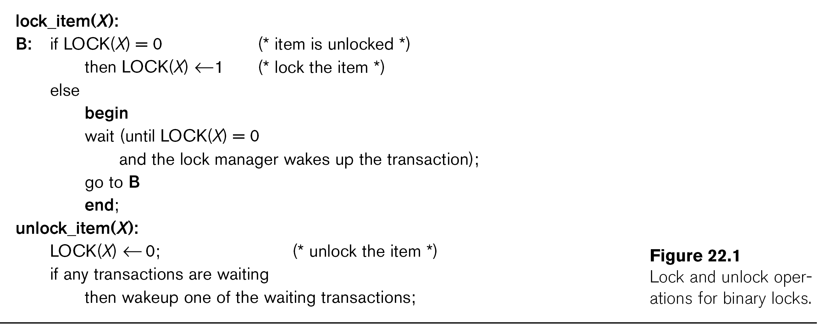

Slide 7
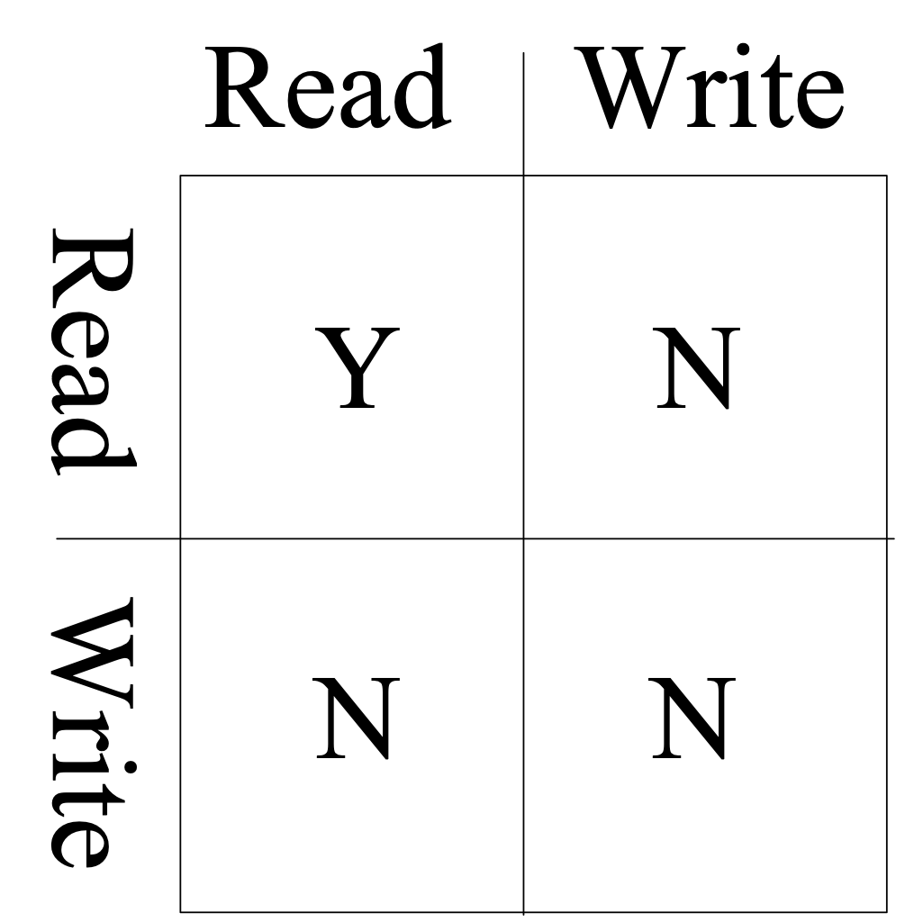
2PL Concurrency Control (cont.)
Locking for database items:
For database purposes, binary locks are not sufficient:
Two locks modes are needed (a) shared lock (read lock) and (b) exclusive lock (write lock).
Shared mode: Read lock (X). Several transactions can hold shared lock on X (because read operations are not conflicting).
Exclusive mode: Write lock (X). Only one write lock on X can exist at any time on an item X. (No read or write locks on X by other transactions can exist).
Conflict matrix

Slide 8
2PL Concurrency Control (cont.)
Three operations are now needed:
read_lock(X): transaction T requests a read (shared) lock on item X
write_lock(X): transaction T requests a write (exclusive) lock on item X
unlock(X): transaction T unlocks an item that it holds a lock on (shared or exclusive)
Transaction can be blocked (forced to wait) if the item is held by other transactions in conflicting lock mode
Conflicts are write-write or read-write (read-read is not conflicting)
Next slide gives outline of these three operations

Slide 9
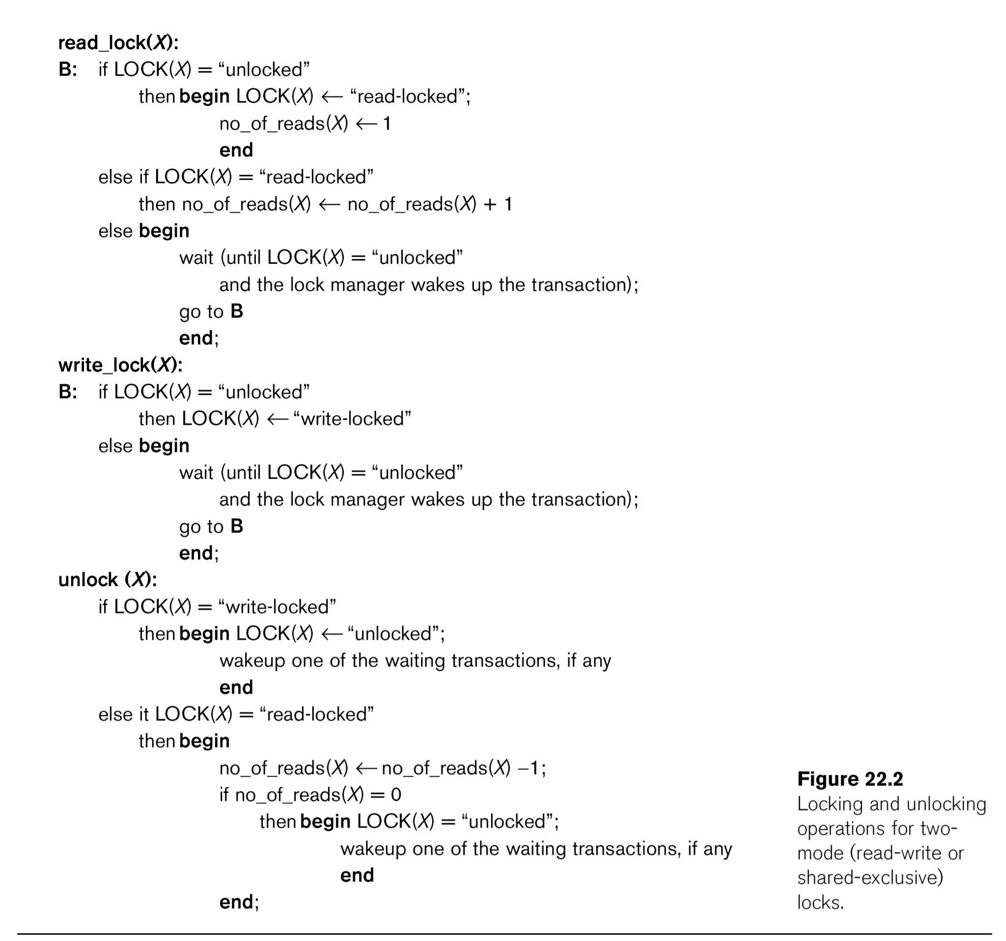

Slide 10
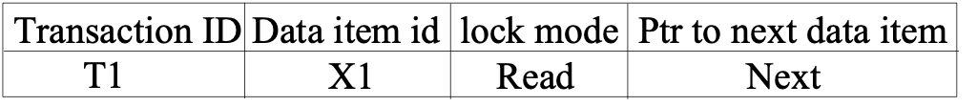
2PL Concurrency Control (cont.)
Two-Phase Locking Techniques: Essential components
Lock Manager: Subsystem of DBMS that manages locks on data items.
Lock table: Lock manager uses it to store information about locked data items, such as: data item id, transaction id, lock mode, list of waiting transaction ids, etc. One simple way to implement a lock table is through linked list (shown). Alternatively, a hash table with item id as hash key can be used.

Slide 11
2PL Concurrency Control (cont.)
Rules for locking:
Transaction must request appropriate lock on a data item X before it reads or writes X.
If T holds a write (exclusive) lock on X, it can both read and write X.
If T holds a read lock on X, it can only read X.
T must unlock all items that it holds before terminating
(also T cannot unlock X unless it holds a lock on X).

Slide 12
2PL Concurrency Control (cont.)
Lock conversion
Lock upgrade: existing read lock to write lock
if Ti holds a read-lock on X, and no other Tj holds a read-lock on X (i ≠ j), then
it is possible to convert (upgrade) read-lock(X) to write-lock(X)
else
force Ti to wait until all other transactions Tj that hold read locks on X release their locks
Lock downgrade: existing write lock to read lock
if Ti holds a write-lock on X
(*this implies that no other transaction can have any lock on X*)
then it is possible to convert (downgrade) write-lock(X) to read-lock(X)

Slide 13
2PL Concurrency Control (cont.)
Two-Phase Locking Rule:
Each transaction should have two phases: (a) Locking (Growing) phase, and (b) Unlocking (Shrinking) Phase.
Locking (Growing) Phase: A transaction applies locks (read or write) on desired data items one at a time. Can also try to upgrade a lock.
Unlocking (Shrinking) Phase: A transaction unlocks its locked data items one at a time. Can also downgrade a lock.
Requirement: For a transaction these two phases must be mutually exclusively, that is, during locking phase no unlocking or downgrading of locks can occur, and during unlocking phase no new locking or upgrading operations are allowed.

Slide 14
2PL Concurrency Control (cont.)
Basic Two Phase Locking:
When transaction starts executing, it is in the locking phase, and it can request locks on new items or upgrade locks. A transaction may be blocked (forced to wait) if a lock request is not granted. (This may lead to several transactions being in a state of deadlock)
Once the transaction unlocks an item (or downgrades a lock), it starts its shrinking phase and can no longer upgrade locks or request new locks.
The combination of locking rules and 2-phase rule ensures serializable schedules
Theorem: If every transaction in a schedule follows the 2PL rules, the schedule must be serializable.

Slide 15
2PL Concurrency Control (cont.)
Other Variations of Two-Phase Locking:
Conservative 2PL: A transaction must lock all its items before starting execution. If any item it needs is not available, it locks no items and tries again later. Conservative 2PL has no deadlocks since no lock requests are issued once transaction execution starts.
Strict 2PL: All items that are writelocked by a transaction are not released (unlocked) until after the transaction commits. This is the most commonly used two-phase locking algorithm, and ensures strict schedules (for recoverability).
Rigorous 2PL: All items that are writelocked or readlocked by a transaction are not released (unlocked) until after the transaction commits. Also guarantees strict schedules.

Slide 16
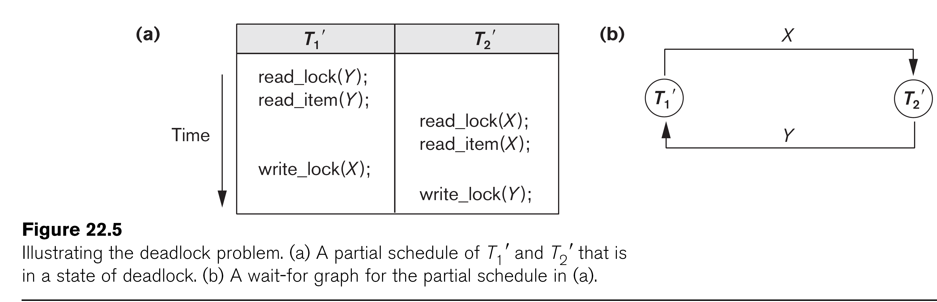
2PL Concurrency Control (cont.)
Deadlock Example (see Figure 22.5)
T1' T2'
read_lock (Y); T1' and T2' did follow two-phase
read_item (Y); policy but they are deadlock
read_lock (X);
read_item (Y);
write_lock (X);
(waits for X) write_lock (Y);
(waits for Y)
Deadlock (T1' and T2')

Slide 17
2PL Concurrency Control (cont.)
Dealing with Deadlock
Deadlock prevention
System enforces additional rules (deadlock prevention protocol) to ensure deadlock do not occur – many protocols
Deadlock detection and resolution
System checks for a state of deadlock – if a deadlock exists, one of the transactions involved in the deadlock is aborted

Slide 18
2PL Concurrency Control (cont.)
1. Deadlock detection and resolution
In this approach, deadlocks are allowed to happen. The system maintains a wait-for graph for detecting cycles. If a cycle exists, then one transaction involved in the cycle is selected (victim) and rolled-back (aborted).
A wait-for graph contains a node for each transaction. When a transaction (say Ti) is blocked because it requests an item X held by another transaction Tj in conflicting mode, a directed edge is created from Ti to Tj (Ti is waiting on Tj to unlock the item). The system checks for cycles; if a cycle exists, a state of deadlock is detected (see Figure 22.5).

Slide 19
2PL Concurrency Control (cont.)
2. Deadlock prevention
There are several protocols. Some of them are:
1. Conservative 2PL, as we discussed earlier.
2. No-waiting protocol: A transaction never waits; if Ti requests an item that is held by Tj in conflicting mode, Ti is aborted.
3. Cautious waiting protocol: If Ti requests an item that is held by Tj in conflicting mode, the system checks the status of Tj; if Tj is not blocked, then Ti waits – if Tj is blocked, then Ti aborts. Reduces the number of needlessly aborted transactions

Slide 20
2PL Concurrency Control (cont.)
2. Deadlock prevention (cont.)
4. Wound-wait and wait-die: Both use transaction timestamp TS(T), which is a monotonically increasing unique id given to each transaction based on their starting time
TS(T1) < TS(T2) means that T1 started before T2 (T1 older than T2)
(Can also say T2 younger than T1)
Wait-die:
If Ti requests an item X that is held by Tj in conflicting mode, then
if TS(Ti) < TS(Tj) then Ti waits (on a younger transaction Tj)
else Ti dies (if Ti is younger than Tj, it aborts)
[In wait-die, transactions only wait on younger transactions that started later, so no cycle ever occurs in wait-for graph – if transaction requesting lock is younger than that holding the lock, requesting transaction aborts (dies)]

Slide 21
2PL Concurrency Control (cont.)
2. Deadlock prevention (cont.)
4. Wound-wait and wait-die (cont.):
Wound-wait:
If Ti requests an item X that is held by Tj in conflicting mode, then
if TS(Ti) < TS(Tj) then Tj is aborted (Ti wounds younger Tj)
else Ti waits (on an older transaction Tj)
[In wound-wait, transactions only wait on older transactions that started earlier, so no cycle ever occurs in wait-for graph – if transaction requesting lock is older than that holding the lock, transaction holding the lock is preemptively aborted]

Slide 22
Database Concurrency Control
Dealing With Starvation
Starvation occurs when a particular transaction consistently waits or gets restarted and never gets a chance to proceed further. Solution is to use a fair priority-based scheme that increases the priority for transaction the longer they wait.
Examples of Starvation:
1. In deadlock detection/resolution it is possible that the same transaction may consistently be selected as victim and rolled-back.
2. In conservative 2PL, a transaction may never get started because all the items needed are never available at the same time.
3. In Wound-Wait scheme a younger transaction may always be wounded (aborted) by a long running older transaction which may create starvation.

